Slide 1

Group 03 Study Buddy
Anika Siddiqui Mayesha
Rumaysa Babulkhair (Team Lead)
Yurii Sykal
Lorenzo Palleschi

Slide 2
Agenda
Feature plan
Survey methods
Logo Evaluation
System Updates

Slide 3

Feature plan

Slide 4

Survey Methods

Slide 5
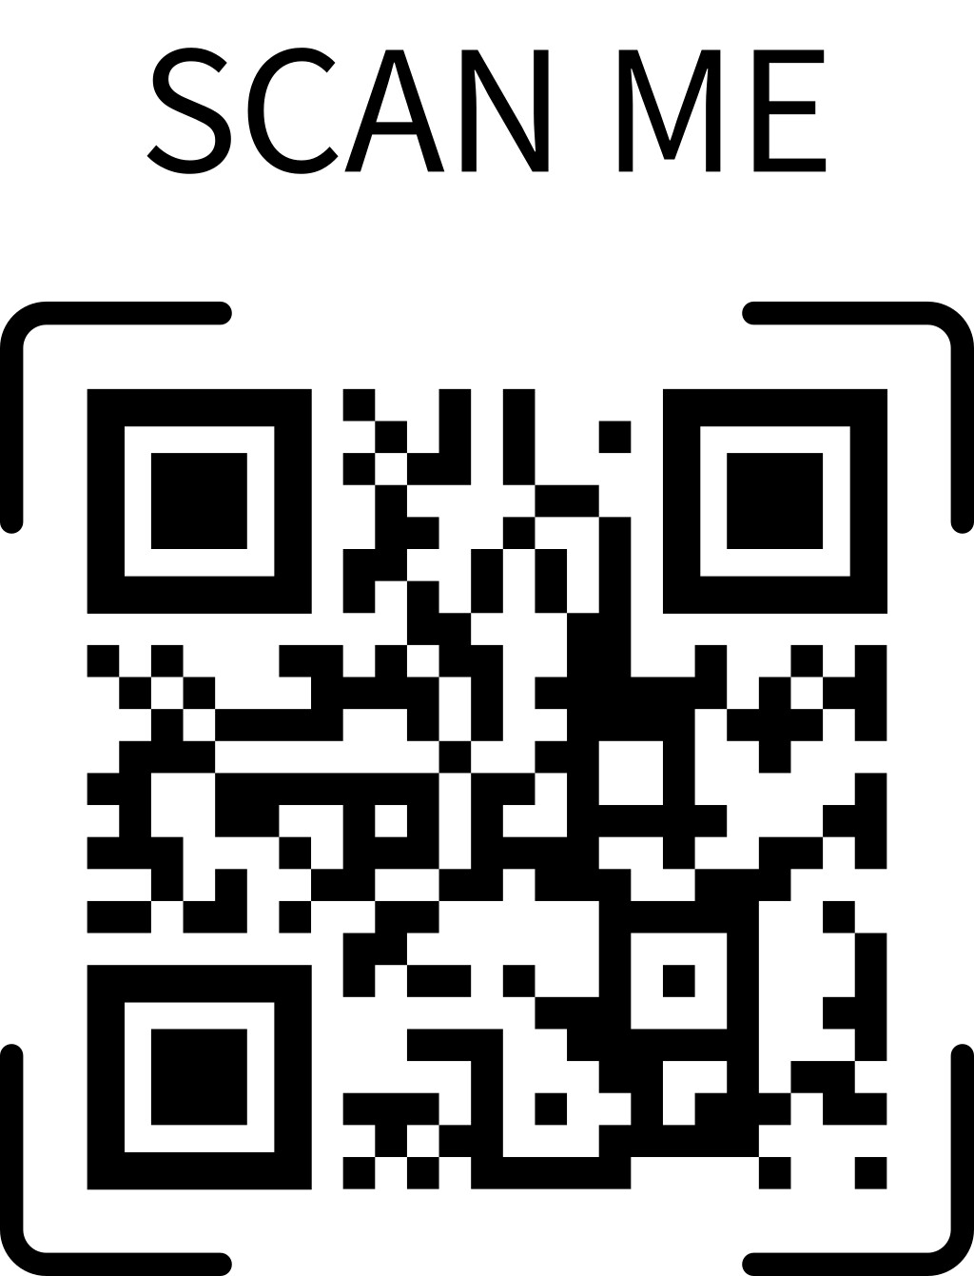
Logo Design Evaluation

Slide 6
System Updates

Slide 7
Retrospective — This Week

Slide 8

Any Questions?

